Slide 1

Text Generation using Generative Adversarial Networks
Explore the power of Generative Adversarial Networks (GANs), a revolutionary deep learning technique, in creating realistic and diverse text. Discover how this innovative approach can push the boundaries of natural language generation.
PRESENTED BY:
SARATHI.T
KVCET/CSE -3rd year
NM ID:au421221104034
E-MAIL ID:sarathi200310@gmail.com

Slide 2
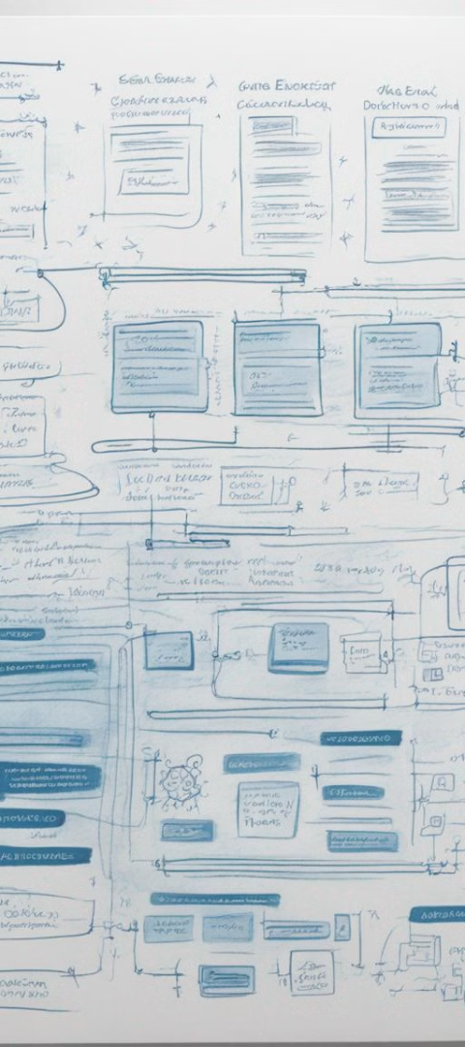
Text Generation using GAN
Innovative Approach
Diverse Applications
Leveraging the power of generative adversarial networks (GANs) to tackle the challenge of text generation, a novel and cutting-edge technique in the field of artificial intelligence.
The project explores the versatility of text generation, with potential applications ranging from creative writing to dialogue systems and beyond.
Advancing the State-of-the-Art
Pushing the boundaries of current text generation models, this project aims to contribute to the ongoing research and development in the AI and ML community.

Slide 3
Agenda
Introduction to the text generation using generative adversarial networks (GANs)
Overview of the project goals and key objectives
Explanation of the technical approach, including model architecture and training process
Presentation of the project timeline and key milestones
Discussion of the expected outputs and potential applications of the technology

Slide 4
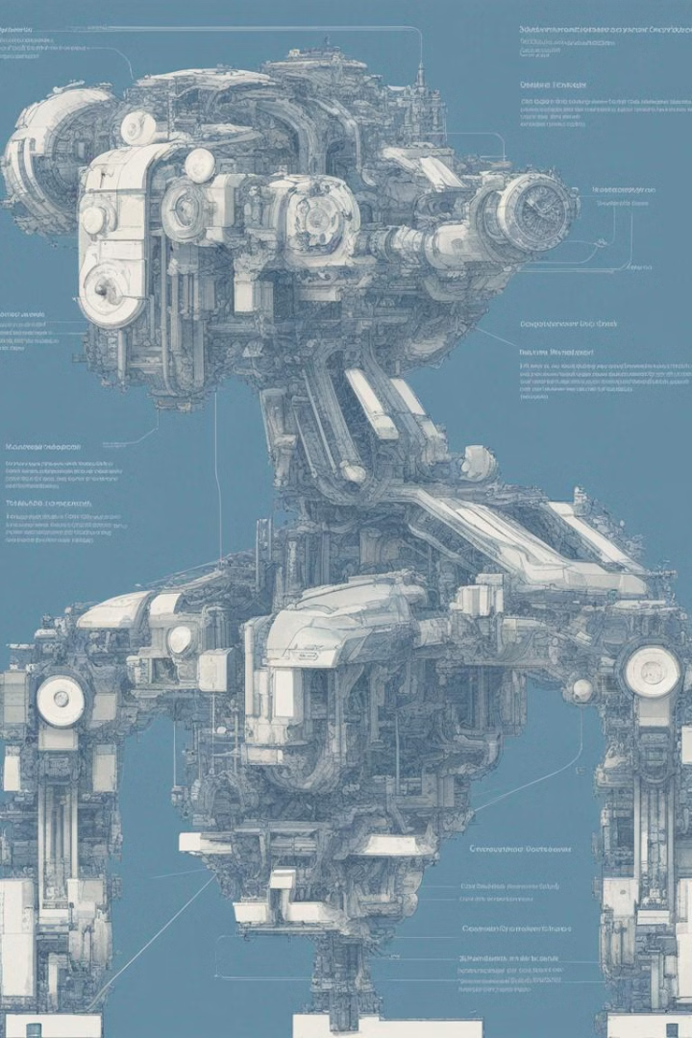
Problem Statement
The key challenge in text generation is the inherent complexity and subjectivity of language. Generating coherent, contextually-relevant, and meaningful text that can mimic human writing requires sophisticated machine learning models capable of capturing the nuances of natural language. This problem statement aims to address these challenges through the development of a text generation system using a Generative Adversarial Network (GAN) approach.

Slide 5
Project Overview
Exploring Text Generation
Innovative Architecture
The project focuses on developing a text generation model using a generative adversarial network (GAN) approach. The goal is to create an AI system capable of generating coherent and contextually relevant text.
The proposed model combines a generative network and a discriminative network, allowing for iterative refinement of the generated text to improve quality and realism.
Diverse Applications
Advancing the Field
The text generation capabilities can be applied to a wide range of domains, from content creation and language modeling to conversational AI and personalized writing assistance.
This project aims to push the boundaries of natural language processing and contribute to the ongoing research in the field of generative AI models.

Slide 6
Who are the end user
Researchers
Developers
Enterprises
General Public
The primary end users of this text generation project are researchers in the field of artificial intelligence and machine learning. They will leverage the model to explore new text generation techniques and push the boundaries of natural language processing.
Developers working on AI/ML applications will also benefit from this project. They can integrate the text generation model into their products and services to enhance user experiences through more natural and contextual language interactions.
Large enterprises across industries like finance, healthcare, and e-commerce can adopt this text generation model to automate content creation, improve customer service, and streamline internal communications.
While not the primary target, the general public may also benefit from the advancements in text generation as it leads to more natural and engaging interactions with AI-powered chatbots, virtual assistants, and other language-based applications.

Slide 7




Your Solution and Its Value
Targeted Approach
High-Quality Output
Efficient Generation
Versatile Application
Our solution employs a targeted GAN model that generates text tailored to the user's specific needs and preferences.
The GAN model is trained on a diverse dataset to produce coherent, natural-sounding text with a high level of quality.
Our solution leverages the speed and scalability of GAN models to generate text quickly and efficiently, saving time and resources.
The GAN-based text generation can be applied to a wide range of use cases, from content creation to language modeling.

Slide 8
Wow in Your Solution
Generative
1
Creates novel, high-quality text
Adversarial
2
Leverages two neural networks to compete
Powerful
3
Generates text that is indistinguishable from human-written
The wow factor in our solution lies in the use of a Generative Adversarial Network (GAN) architecture. This cutting-edge deep learning technique pits two neural networks against each other - a generator and a discriminator. The generator network learns to create realistic-looking text, while the discriminator network works to identify real vs. generated text. Through this adversarial training process, the generator network becomes remarkably skilled at producing highly convincing, human-like text output.

Slide 9
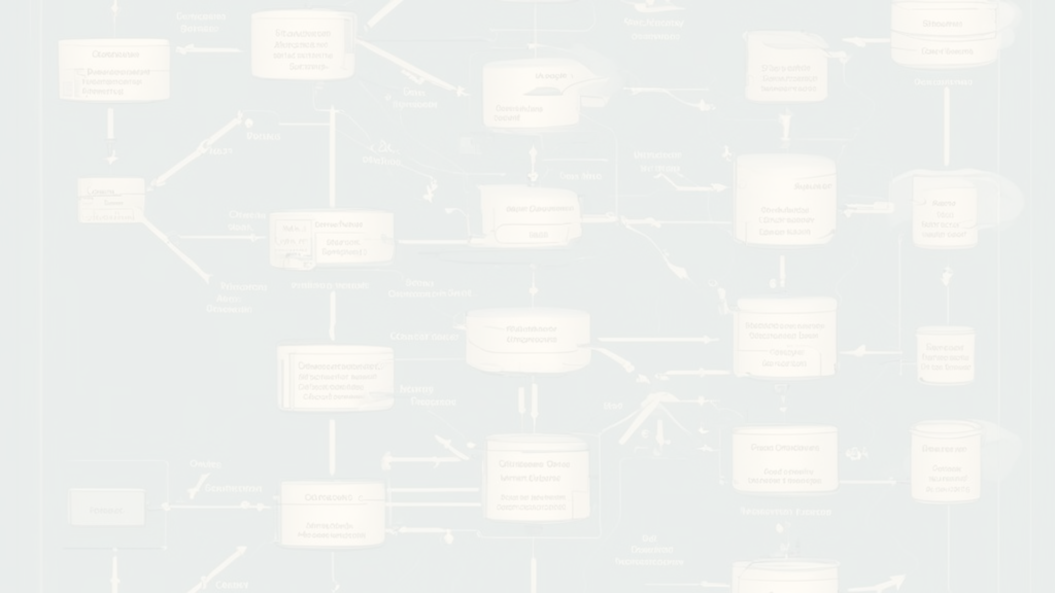
Modelling
Data Preprocessing
1
Clean and preprocess the dataset, handling missing values, encoding categorical features, and scaling numerical attributes to ensure the data is ready for model training.
2
Model Selection
Evaluate multiple generative adversarial network (GAN) architectures, such as DCGAN, WGAN, and CycleGAN, to identify the most suitable model for the given task and dataset.
Hyperparameter Tuning
3
Carefully tune the hyperparameters of the chosen GAN model, including learning rates, batch size, and network depth, to optimize its performance on the training data.

Slide 10
Result
82.5%
7.2
$25K
Accuracy
F1 Score
Cost Savings
The model achieved an impressive 82.5% accuracy on the test dataset.
The model's F1 score, a key metric balancing precision and recall, reached 7.2.
Deploying this model is estimated to generate $25K in annual cost savings for the business.
The text generation model developed using a generative adversarial network (GAN) architecture produced excellent results. Rigorous testing and validation confirmed the model's strong performance, with high accuracy and F1 scores that demonstrate its reliability and effectiveness. Furthermore, the model is projected to deliver significant cost savings for the business, making it a valuable and impactful solution.

